Slide 1
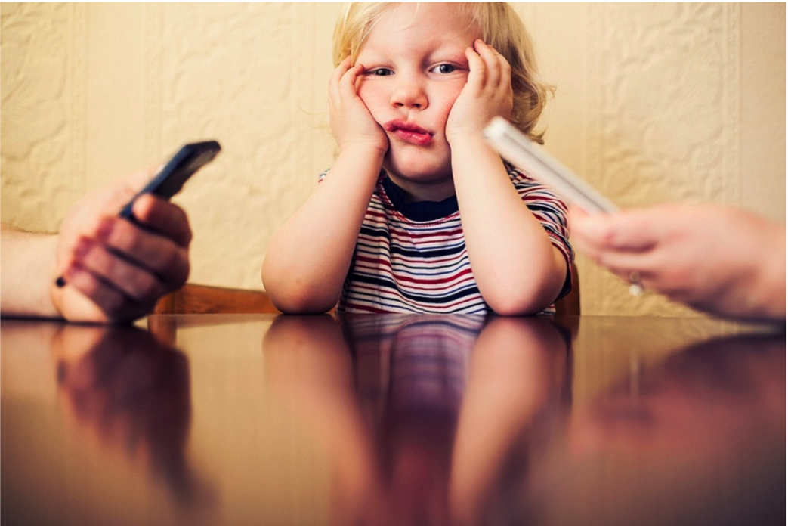
The Frustrations and Benefits of Mobile Device Usage in the Home when Co-Present with Family Members
Erick Oduor (IBM Research Africa), Carman Neustaedter, William Odom, Niala Moallem (Simon Fraser University), Tony Tang (University of Calgary), Melanie Tory (Tableau) and Pourang Irani (University of Manitoba)

Slide 2
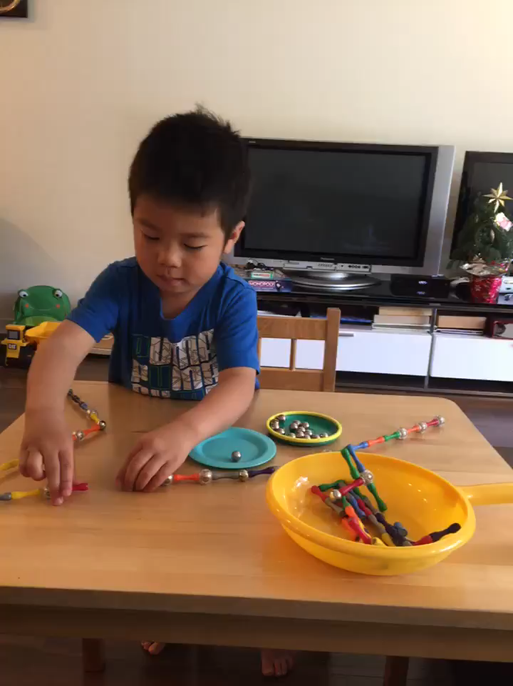
Notes:
I want to take you through a story that frequently happens at my household.
It is 5:30. Our three year old son is happily at home. Tony, the dad is preparing dinner so that when his wife gets home, she will have something to eat. Cheryl gets home, and Tony suggests that she play with Anson while he is continuing to prep the family meal. But, instead of playing with the kid or talking to him, wife picks up phone and starts doing something on the phone. Husband can’t believe that she’s texting away with her friends rather than spending time with their beautiful son. So he starts reaming her out. Turns out that she was looking up travel plans for their upcoming trip to Brisbane. And the evening ends in disaster as everyone’s mad at everyone.
Q: Do we need to go to marriage counselling? Is it just us?
There may be some people whose names and roles may be changed in this story.

Slide 3
Notes:
So this is where we started on our thinking – not specifically me, but thinking about those kinds of daily interactions we have at home. Are we unique because we’re academics? Because we’re nerds? Or does this happen to other people? In what ways?
As a teaser, I’m going to be giving you some marital advice – FREE OF CHARGE. And I think it’s good.
But, I’m thinking now that since I told you about my family, you might not take it. So, I think it’s up to you. It’s free after all.

Slide 4
Message
Family members often become frustrated when others do non-urgent activities on their mobile phones in the presence of others when at home.
However, there is a lack of true activity awareness that suggests design directions.
Notes:
Here’s the message of the talk: [read]
We’re going to get here mainly in this talk in two parts. First, I’ll outline a study that we designed where we asked people to track their use of their phones at home, and interviewed them about their feelings about these uses. Second, I’ll outline some of the findings from the study that get us to this point.
I want to be very clear on one point here. We do not have a specific agenda here against mobile phones. The question is /why/ are they so frustrating, and what can we do about it? Would people be as annoyed if we were talking about newspapers or books? What is it about phones that make people so frustrated?

Slide 5
Related Work
Mobile phones in domestic life: Coordination among work colleagues, family & friends Beech et al., (2004), Brush et al., (2007), Greenberg et al., (2009), Leshed et al., (2014), Palen and Hughes, (2007)…
Mobile devices and children: How parents use mobile devices around children Radesky et al., (2014), Hiniker et al., (2015), Steiner Adair & Baker (2013), Ko et al., (2015), Mark et al., (2012), Odom et al., (2012)…
Technology non-use and slow technologies: Explore people’s desire to limit their technology use Baumer et al., (2014), Crary, (2013), Hillman et al., (2014).
Notes:
To set the stage a little, there’s a lot of really great work out there exploring how people use mobile phones in their everyday lives, particularly within their domestic lives

Slide 6
Related Work
Mobile phones in domestic life: Coordination among work colleagues, family & friends Beech et al., (2004), Brush et al., (2007), Greenberg et al., (2009), Leshed et al., (2014), Palen and Hughes, (2007)…
Mobile devices and children: How parents use mobile devices around children Radesky et al., (2014), Hiniker et al., (2015), Steiner Adair & Baker (2013), Ko et al., (2015), Mark et al., (2012), Odom et al., (2012)…
Technology non-use and slow technologies: Explore people’s desire to limit their technology use Baumer et al., (2014), Crary, (2013), Hillman et al., (2014).
Notes:
To focus us here a bit, we know that phone use is important. It allows us to microcoordinate in ways that we could not before. For example, rather than necessarily having to set a time up to meet you at the train station, I might tell you to text me once you get there – just so we can meet up at the right time. One reason is that we know now that people keep their mobile phones next to (or on) them almost all the time – they are the devices that are closest to us—metaphorically and physically. We can rely on that, and are often surprised when people don’t respond in a timely way.
Some recent work by Alexis Hiniker and her colleagues about use of phones around children in a playground revealed that it was harder for children to get the attention of parents when parents were occupied with their phones. Further, they responded more slowly to events.
So these ideas inform our work here. Our specific interest is not kids per sey, or necessarily the coordination piece of course. Here, everyone is already collocated, and using their phnones.

Slide 7
Research questions
How do people use mobile devices in the presence of others at home?
How does using devices in shape behavior and household dynamics?
What challenges do people encounter?
Notes:
So, how do people use their phones at home when there are others around? Why do they do it? How does it affect their relationship with others? How does this use shape behaviour and household dynamics? If there are challenges that people encounter, can we design more effectively?
To address these questions, we designed a study where we focused on the experiences of participants in their households. Their role was to document instances of when they used their phoens in the presence of others, and then later in interviews, describe to us each of these experiences – both from a practical, and emotional level.

Slide 8
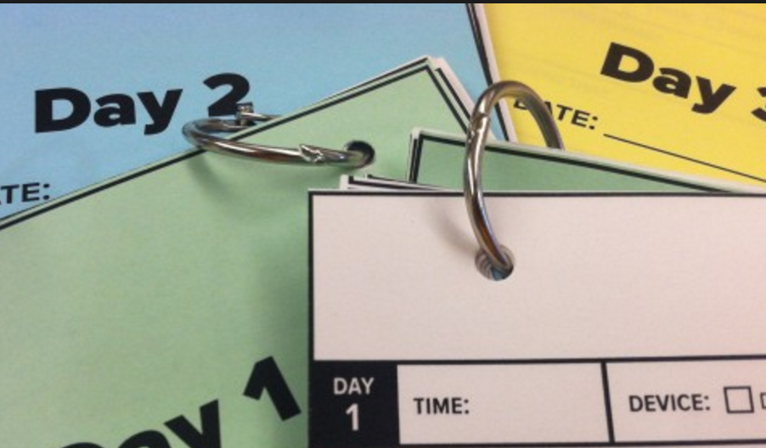
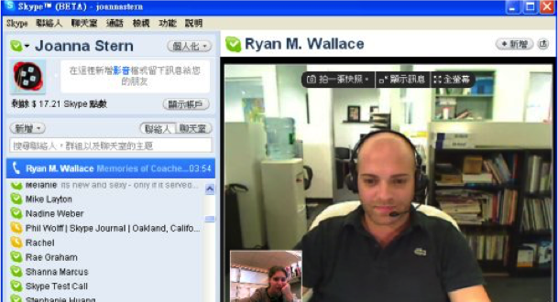
Method
Diaries
Semi-structured interviews
Thematic analysis and coding
Notes:
Two-week diary study: collecting about their own use, and then the use of phones by others. “how did behavior make you feel?”, “did anybody react to your behavior? If so, how?
Semi-structured interviews: “Can you walk me through yesterday and describe the different times you used your mobile device when at home?”, “How do you think other members of your household feel about your mobile device usage?”, “Do you think you should change your mobile device behavior? Why or why not?”, “Do you do anything to reduce your mobile device usage?

Slide 9

Participants
11 females and 9 males (20 to 60 years)
3 had 1 child 3 had 2 children 1 had 3 children
7 were adult children living at home 6 participants were part of a couple
Notes:
We recruited 20 participants (11 female) from various locations across North America. Our recruitment messages deliberately called for people who may be feeling tensions over mobile device usage in their home, as well as those who used mobile phones in the presence of family members. Thus, our sample is likely biased in this regard.
We selected participants with a highly varied cross section of family types. Participants ranged in age from 20 to 60 years old. 7 of 20 participants lived in homes with at least one child, three had two children, one had three children, and three had one child.
The ages of children varied between infants (less than one year) and teenagers (up to 18 years).
7 of 20 participants were adult children living at home with parents and/or grandparents.
The remaining 6 of 20 participants were couples that were either married or living together – one was an empty nest couple. The ethnicities of participants included Caucasian, Chinese, Persian, and African, and all spoke fluent English as either a first or second language.

Slide 10
Findings
Why people use their mobile devices
Reactions to the device usage of others
The privacy of mobile phones
Strategies to avoid conflict

Slide 11
Findings
Why people use their mobile devices
Reactions to the device usage of others
The privacy of mobile phones
Strategies to avoid conflict (free marital advice)

Slide 12
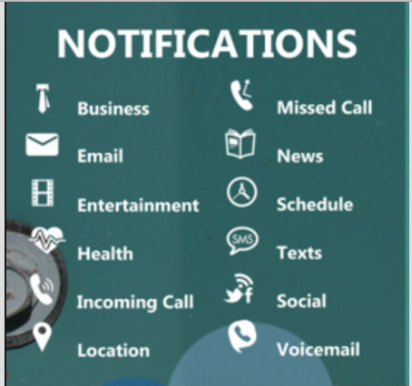
Why people use their mobile devices
Notifications spiral into other activities
Boredom while spending time together
Notes:
Lull in the conversation – an opportunity to do something “guilt free”
Overall, participants reported that as long as they were using their mobile devices in a similar manner to people around them, then they did not see a problem.
Participants told us that most of the activities they did on their mobile devices were not urgent and it would be fine if others interrupted them.
-- YouTube videos shared up to the wall display, etc.

Slide 13
Why people use their mobile devices
Notifications spiral into other activities
Boredom while spending time together
Good of the group
Notes:
Overall, participants reported that as long as they were using their mobile devices in a similar manner to people around them, then they did not see a problem.
Participants told us that most of the activities they did on their mobile devices were not urgent and it would be fine if others interrupted them.
-- YouTube videos shared up to the wall display, etc.

Slide 14
“Good of the group”
“I used my phone to look up the distance to [a vacation destination] while in conversation with others around the table. I wasn't sure how long it would take to drive there. I told them 'I'm not sure how far it is... hold on, I can check.' I got out my phone...and looked it up.” –P15 – diary entry

Slide 15
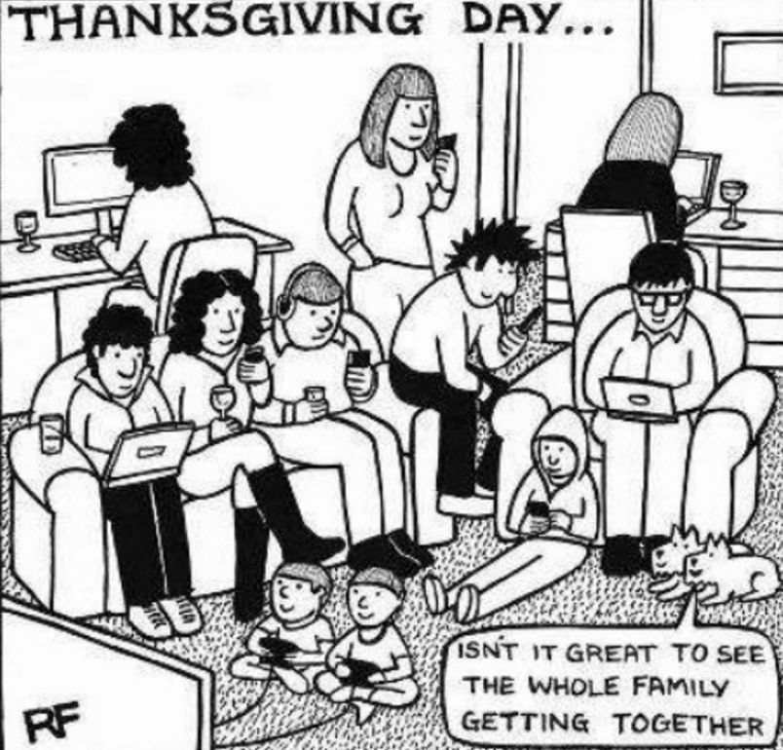
Reaction to mobile device usage of others
Social disconnect, frustration, conflict
Notes:
Couples described feeling excluded or ignored as a result of mobile device usage
It was clear from our data that people had strong feelings in-the-moment and later that day when writing about the situations in their study diary.
Two participants used their mobile devices as leverage for taking on parenting duties or not.

Slide 16
Participant quote
“I got frustrated with my wife being on the phone, using the phone while I'm talking to her, and she claims that she's paying attention, but I don't think she is.” – P4, Male, Child Age 2

Slide 17
Participant quote
“[My husband] had a couple of these games where you have to go on and participate in these different phases of battles, or something. I don't mind most of the time, but sometimes the phase of the battle he has to participate in happens during dinner or when we're out with the kids, and then I watch it, and he thinks he's not distracted, but he is.” – P3, Female, Children Ages 1 & 4

Slide 18
Reaction to mobile device usage of others
Social disconnect, frustration, conflict
Desirable disengagement
Notes:
Not all bad

Slide 19
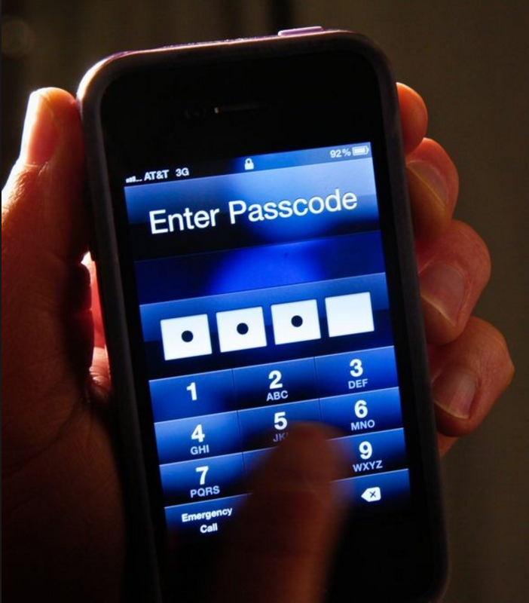
The privacy of mobile phones
Assumptions and lack of awareness – body language, past history and interaction styles
“Attribution error”
Notes:
Of course, what is happening here is that people are usually guessing at what their partner is doing. The phone itself does not reveal to others what is happening because of the design of its screen – it is meant mainly for the person interacting with it.
So, people use things like body language, or their understanding of how the phone is being held/their past history with using the phone, etc. to guess what is going on. So for instance, if you’re laughing at something and I hear some dinging, I assume you’re texting with your friend. If you’re holding your phone sideways, I assume you’re playing a video game.

Slide 20
Awareness problem?
“I guess my frustrations is around that because it's such a personal device... It's not like the computer…because I …can understand what's happening, but you can't really with personal devices.” – P3, Children ages, 1 & 4

Slide 21
The privacy of mobile phones
Assumptions and lack of awareness – body language, past history and interaction styles
“Attribution error”
Notes:
In most cases, even when a person did not know for sure what his or her family members were doing, participants assumed that the activity could wait until later.
Thus, they felt that the mobile device usage was a behavioral issue rather than something that might actually require immediate action.
Attribution error - ten participants’ felt their own behaviours were reasonable given contextual factors such as urgency. But generally, they did not feel their partner’s actions were justified. This is kind of funny, right? Basically: when I’m using my phone, it’s justified, I’m not a jerk – there are outside forces making me do it AND! I’ll be fast!! But, when YOU use your phone, you’re a jerk and inconsiderate of my time.

Slide 22
The privacy of mobile phones
Assumptions and lack of awareness – body language, past history and interaction styles
“Attribution error”: external factors are driving my use; your use is inconsiderate because you are inconsiderate.
Notes:
In most cases, even when a person did not know for sure what his or her family members were doing, participants assumed that the activity could wait until later.
Thus, they felt that the mobile device usage was a behavioral issue rather than something that might actually require immediate action.
Attribution error - ten participants’ felt their own behaviours were reasonable given contextual factors such as urgency. But generally, they did not feel their partner’s actions were justified. This is kind of funny, right? Basically: when I’m using my phone, it’s justified, I’m not a jerk – there are outside forces making me do it AND! I’ll be fast!! But, when YOU use your phone, you’re a jerk and inconsiderate of my time.

Slide 23

Strategies to avoid conflict a.k.a. marital counselling 101
Regulated interactions
Mobile device placement
No strategies
Awareness through talk aloud
Notes:
Other participants would try to only have very short interactions in an effort to quickly return to their current activity after checking their device.
For example, P16 would sometimes answer her phone during meal times and then quickly let callers know that she would get back to them after she was done eating.
She welcomed this lack of usage, but at times found it hard to do because she felt there was always a chance that an important call might come in and she would miss it.
Five participants said they did not have any strategies to avoid potential issues with mobile device usage. They had either not developed any or felt that their usage was fine.

Slide 24
”Making public” what is happening
“I often put my phone on speaker when I want family members to know what I am engaging in using my phone. Other times when I am in a private conversation I constantly remind them that I am listening to them but just talking to a friend.” – P10, Adult Child at Home

Slide 25

Guilt and changing device behavior
Usage in comparison to other family members
Perception on one’s view on device use
Views on other family member’s usage patterns
Notes:
Participants were divided on whether they should change their existing mobile device behavior.
Eleven participants felt that they should change their mobile phone behaviors for various reasons.
Half of our participants wanted to decrease their family members’ usage in addition to their own. Thus, reducing usage was seen more as a group or couple activity, rather than something that was individual in nature.
Typically participants who wanted to change their behavior did not necessarily know where to begin (also found by [13] in playground settings with children).
Others felt that it might be hard to put their mobile phone away in case emergencies arose; they worried about missing important items.

Slide 26
Participant quote
“I also think that I should not change my behavior yet since I only got a smart phone last year mainly to talk to my parents.” – P10, Adult Child at Home

Slide 27
Discussion and implications
Families felt need to be connected, but generally, phones seem to make others feel disengaged with the user
Frustrations and tensions also emerged
Notes:
Our study revealed that the usage of mobile devices at home among others can produce a range of benefits and drawbacks.
We see these frustrations as an entangled social issue afforded by people’s desires to stay connected and acquire timely information and a design issue as such behaviors are often shaped by key ways in which mobile devices and applications are currently designed. For example, notifications indicating that a person should return to a mobile game to advance in a level subtly suggest that she or he ought to attend to such requests. Many of our participants over time felt such attention was required immediately.
So, can we alleviate these frustrations?

Slide 28
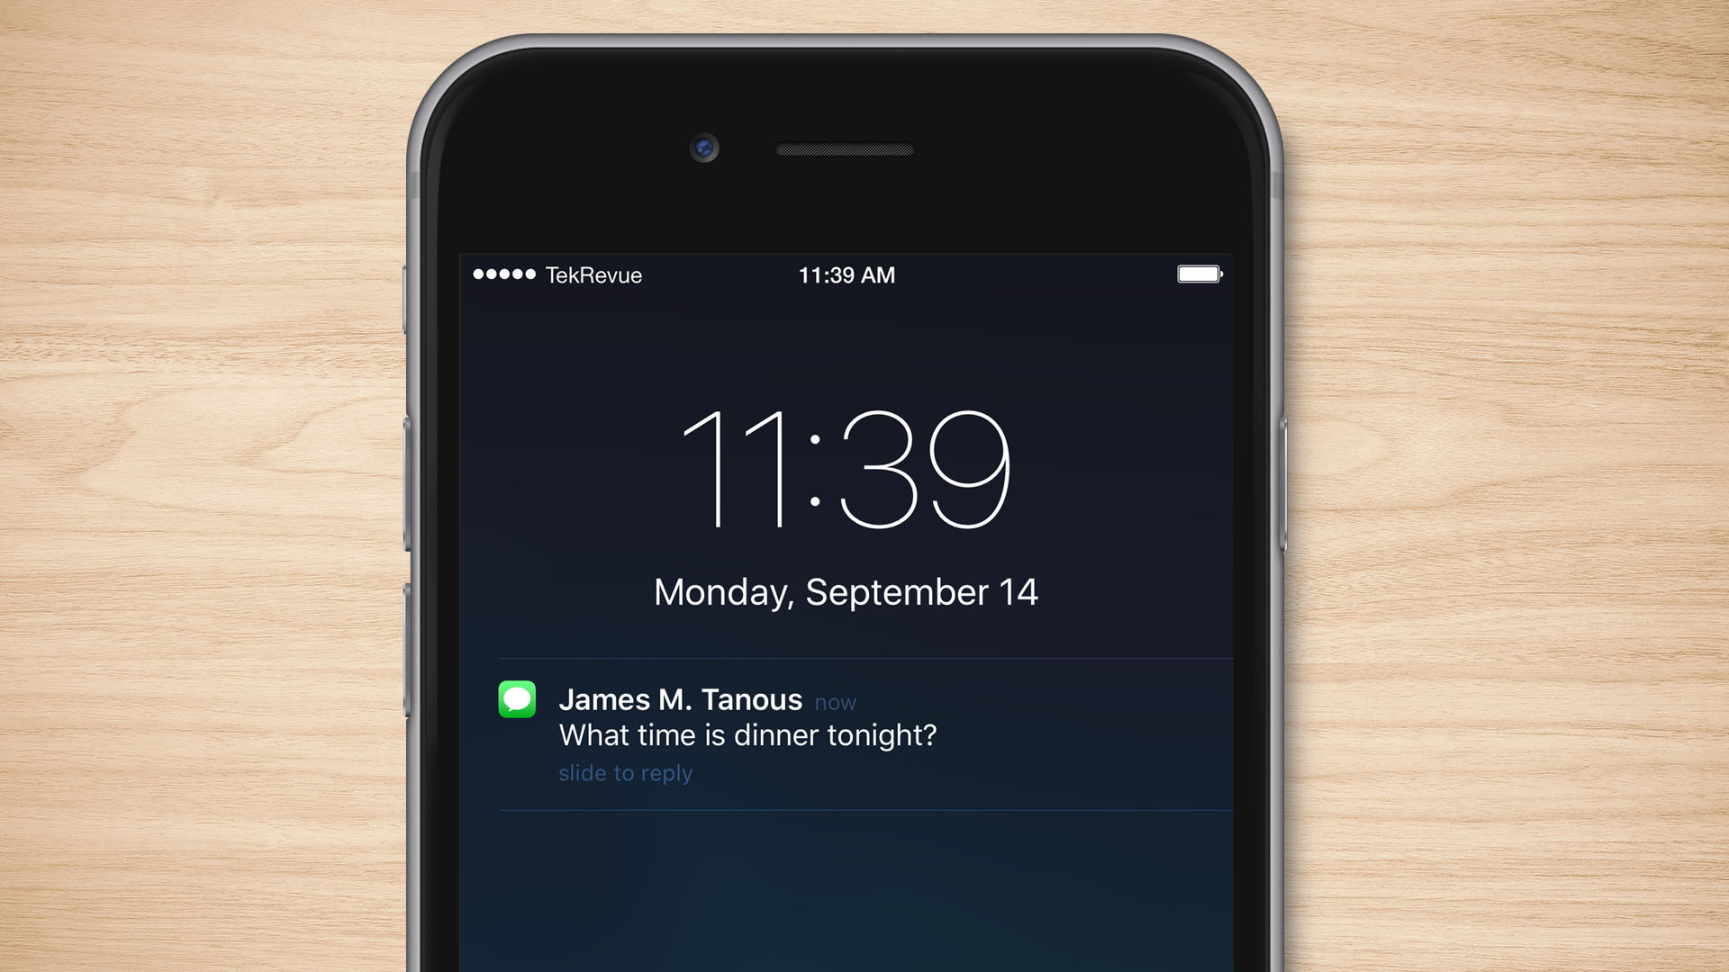
Implications
Notifications?
Potential for wearables
Notes:
We saw notifications can be a trigger for both desirable and undesirable activity. But there’s a bit of a “don’t think about the pink elephant” thing going on.
Trying to be more granular with notifications might be interesting, but family life is hard to articulate as a set of rules situate mobile device usage in the home as a series of rules that dictate domestic interactions and communication sounds appealing, but largely impractical
there is certainly an opportunity to redesign notifications to consider a broader set of contextual information such as who is around and what activities are occurring.
Notifications on wearable devices may offer promise for better balancing mobile device usage since people can quickly glance at a watch, for example, to see what information is incoming without having a high degree of flexibility for further interactions.

Slide 29
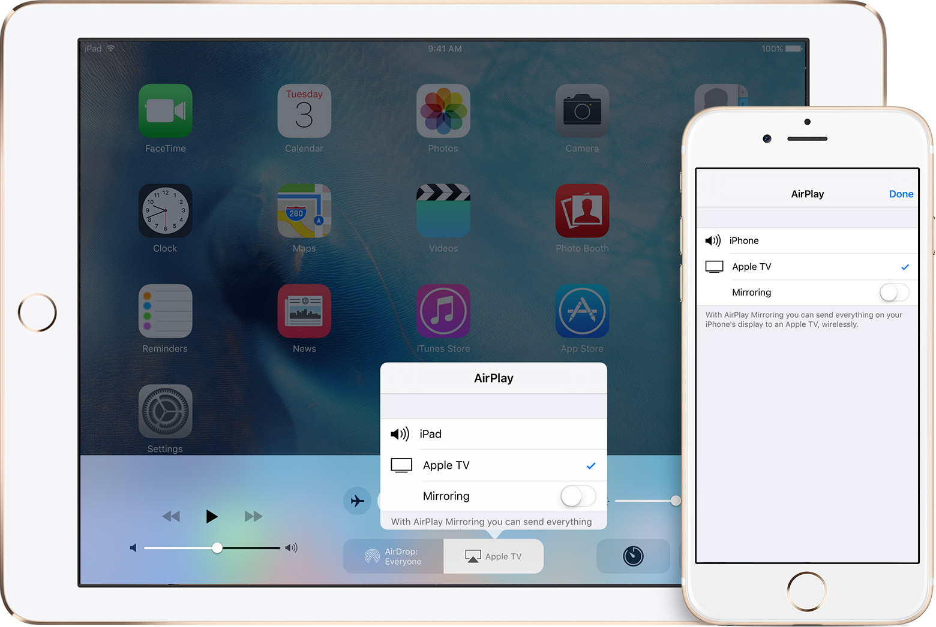
Implications
Activity awareness
Make informed judgments
Voice input may help
Notes:
Can we make people more aware of activities through alternate devices? Would this be a good approach? Unclear.
This caused people to assume they knew what their family members were doing on their mobile devices and they often felt that device usage could wait as a result.
This suggests a clear need for better activity awareness so that family members can make informed judgments about what others are doing
Talk aloud provide opportunity to explore voice - Would conversations migrate from exchanges between people to exchanges between people and devices, or even devices and devices? Could this trend result in people talking more to their mobile phones than to those around them?

Slide 30

Contributions
We describe how mobile devices mediate and shape interactions between collocated family members
We outline possibilities for reducing frustrations caused by domestic phone use
Notes:
Our research makes two main contributions.
First, it provides descriptions of how mobile devices mediate and shape interactions and relationships amongst collocated family members in the home.
Second, it describes implications for future research and design where we raise questions around how designers might reduce feelings of frustration amongst family members and open up new opportunities for nurturing co-located social interactions.

Slide 31

The Message
Family members often become frustrated when others do non-urgent activities on their mobile phones in the presence of others when at home.
However, there is a lack of true activity awareness that suggests design directions.

Slide 32
Thank you!
Erick Oduor (IBM Research Africa), Carman Neustaedter, William Odom, Niala Moallem (Simon Fraser University), Anthony Tang (University of Calgary), Melanie Tory (Tableau) and Pourang Irani (University of Manitoba)

