Slide 1
Ephemerality and Context Ethical Dilemmas in Research in Online Spaces
Tony Tang
University of Calgary
Notes:
~30 mins?
Humans have existed for centuries where social interactions are fundamentaly ephemeral
How many have a facebook, google, twitter, ; privacy settings

Slide 2
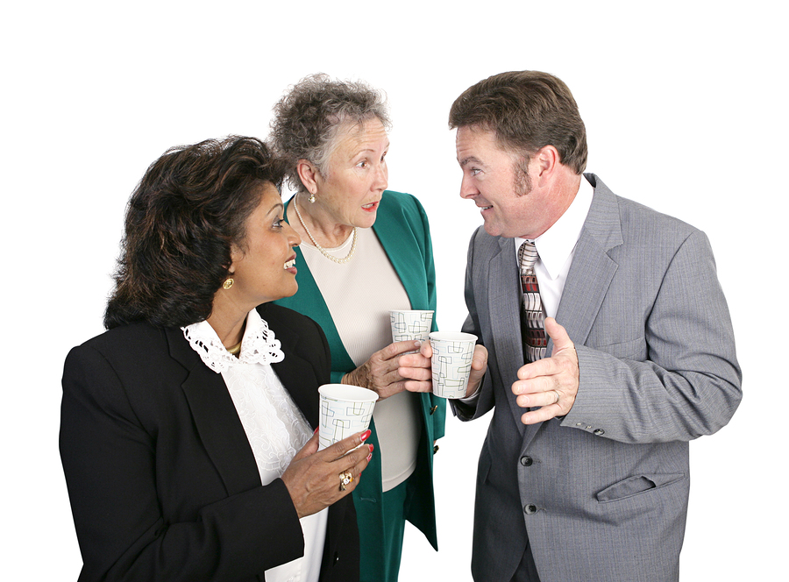
Notes:
http://www.onpurposeconsulting.ca/wp-content/uploads/2015/05/May-13-gossip.jpg

Slide 3
Message
Humans have, for millennia, developed conventions for determining how ephemeral our interactions with others are.
These conventions are beginning to break because of two new technology advances:
  many Internet-based interactions are automatically archived, with unfettered public access, and
  working search engines mean that phrases and “dox’ing” information can be easily found with nominal expertise.
Protecting participants in the face of these technologies is challenging. Or… is it?
Notes:
Two new problems:
Efficient search eliminates anonymity by obscurity.
Ubiquitous indexing is not clear

Slide 4
Emotional Contagion Study
Kramer et al., 2014 – Facebook, Cornell
Emotional contagion: Being around happy people makes you experience happiness; being around sad people makes you sad.
Question: Does this happen in social media spaces?
Notes:
Kramer et al. (2014). Experimental evidence of massive-scale emotional contagion through social networks. PNAS 111(24), 8788-8790.

Slide 5
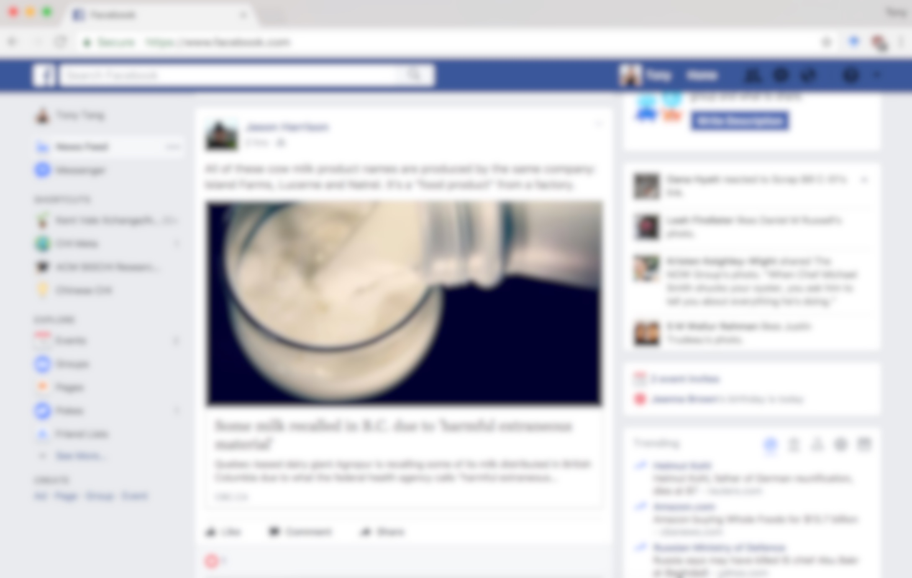
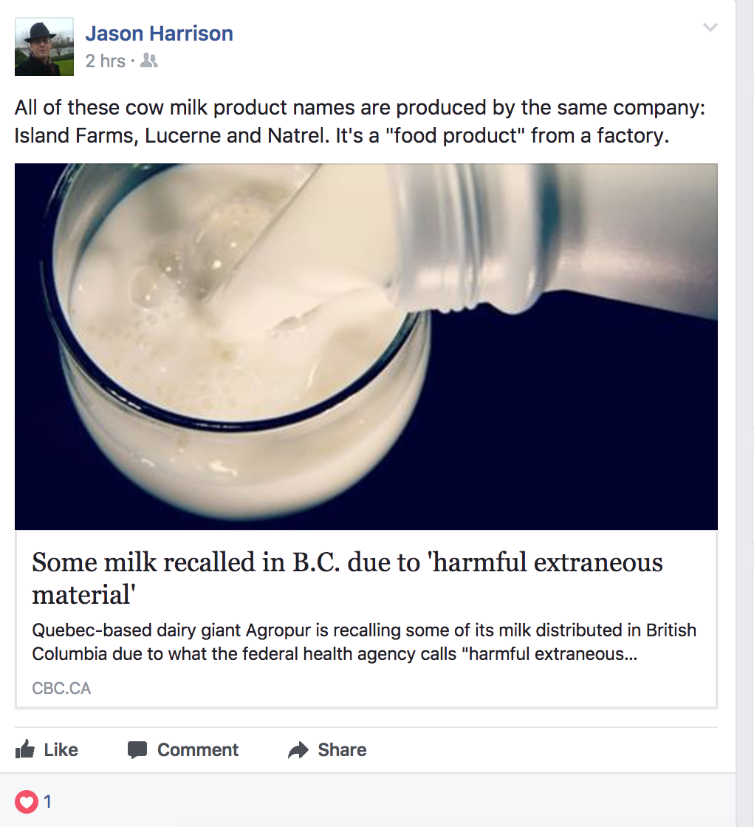
Unhappy

Slide 6
Happy

Slide 7
Emotional Contagion Study
Kramer et al., 2014 – Facebook, Cornell
Emotional contagion: Being around happy people makes you experience happiness; being around sad people makes you sad.
Question: Does this happen in social media spaces?
Opportunity: Beyond correlational findings, we can manipulate what people see!
Study: N=600k+, manipulate “news feeds” to be more positive or more negative (by suppressing posts by others) ➔ is my next post positive or negative?
Notes:
Kramer et al. (2014). Experimental evidence of massive-scale emotional contagion through social networks. PNAS 111(24), 8788-8790.

Slide 8
Emotional Contagion Study
Kramer et al., 2014 – Facebook, Cornell
Emotional contagion: Being around happy people makes you experience happiness; being around sad people makes you sad.
Question: Does this happen in social media spaces?
Opportunity: Beyond correlational findings, we can manipulate what people see!
Study: N=600k+, manipulate “news feeds” to be more positive or more negative (by suppressing posts by others) ➔ is my next post positive or negative?
Finding: Yes!
Notes:
Kramer et al. (2014). Experimental evidence of massive-scale emotional contagion through social networks. PNAS 111(24), 8788-8790.

Slide 9
Emotionally Contagious Backlash
Facebook fiasco: was Cornell's study of ‘emotional contagion’ an ethics breach?
- Guardian, 7/1/2014
  "A covert experiment to influence the emotions of more than 600,000 people. A major scientific journal behaving like a rabbit in the headlights. A university in a PR tailspin"
Facebook Manipulated User News Feeds To Create Emotional Responses
- Forbes, 6/24/2014
Everything We Know About Facebook's Secret Mood Manipulation Experiment
- The Atlantic, 6/28/2014
Facebook’s Unethical Experiment
- Slate, 6/28/2014
Facebook Tinkers With Users’ Emotions in News Feed Experiment, Stirring Outcry
- New York Times, 6/29/2014

Slide 10
Emotionally Contagious Backlash
Facebook fiasco: was Cornell's study of ‘emotional contagion’ an ethics breach?
- Guardian, 7/1/2014
  "A covert experiment to influence the emotions of more than 600,000 people. A major scientific journal behaving like a rabbit in the headlights. A university in a PR tailspin"
Facebook Manipulated User News Feeds To Create Emotional Responses
- Forbes, 6/24/2014
Everything We Know About Facebook's Secret Mood Manipulation Experiment
- The Atlantic, 6/28/2014
Facebook’s Unethical Experiment
- Slate, 6/28/2014
Facebook Tinkers With Users’ Emotions in News Feed Experiment, Stirring Outcry
- New York Times, 6/29/2014

Slide 11
Emotionally Contagious Backlash
Facebook fiasco: was Cornell's study of ‘emotional contagion’ an ethics breach?
- Guardian, 7/1/2014
  "A covert experiment to influence the emotions of more than 600,000 people. A major scientific journal behaving like a rabbit in the headlights. A university in a PR tailspin"
Facebook Manipulated User News Feeds To Create Emotional Responses
- Forbes, 6/24/2014
Everything We Know About Facebook's Secret Mood Manipulation Experiment
- The Atlantic, 6/28/2014
Facebook’s Unethical Experiment
- Slate, 6/28/2014
Facebook Tinkers With Users’ Emotions in News Feed Experiment, Stirring Outcry
- New York Times, 6/29/2014

Slide 12
Post-Mortem
Cornell IRB: Saw the risk to participants as minimal, and deemed the study as not needing additional oversight
Facebook’s TOS now explicitly have users consent to studies
People generally seem to not trust Facebook and large social media organizations (i.e. “The New Microsoft”); this study gave credence to those concerns
My unsolicited opinion: Cornell IRB may have made a mistake
Notes:
TOS: will people read it?
TOS: do I agree in perpetuity? (I don’t know what the study is)

Slide 13
Ellard Litmus Test of Informed Consent
“Given what I know by the end of the study (i.e. knowing what I was to be exposed to/asked to do), would I still have consented to the study in the beginning?”
Note: Dr John Ellard (Psychology, UCalgary) usually uses this litmus test when talking about deception studies.

Slide 15

Tony Tang (not a lawyer)
Associate Professor in Computer Science (Human-Computer Interaction)
How do people interact with technology? How do people interact with one another through technology?
➔ Use this to build better technology
  e.g. How do people communicate with one another in first-person shooter games? ➔ augmented reality technologies for emergency response
  e.g. How can we use social media data to inform “highlight reel” construction for sports games?

Slide 17
Focus today
“Observational methods”
Not compelling people to do something they would not have otherwise done
No manipulating of people’s experiences
“What they [would have done | already did] anyway”
e.g. How do people use Twitter to express political allegiance?
e.g. How do people use online spaces to learn from one another?
e.g. How do people express themselves using video?
…

Slide 18
Outline
TCPS Framework – “first principles”
Is research in online spaces archival research?
Users’ perspectives
Technology perspective
How do we protect participants? Are we being paternalistic?
Things we know about users

Slide 19
TCPS Ethical Framework
Respect for Persons: free, ongoing, informed consent
» inadequate information or understanding for deliberation
Concern for Welfare: protection from risk, ensure confidentiality and anonymity
» promote that welfare in view of any foreseeable risks (e.g. to anonymity) associated with the research
Justice: o
bligation to treat people fairly and equitably

Slide 20
TCPS Ethical Framework
Respect for Persons: free, ongoing, informed consent
» inadequ
ate information or understanding for deliberation
Concern for Welfare: protection from risk, ensure confidentiality and anonymity
» promote that welfare in view of any foreseeable risks (e.g. to anonymity) associated with the research
Justice: obligation to treat people fairly and equitably
d

Slide 21
TCPS Ethical Framework
Respect for Persons: free, ongoing, informed consent
» inadequate information or understanding for deliberation
» respect their implicit/implied desires?
Concern for Welfare: protection from risk, ensure confidentiality and anonymity
» promote that welfare in view of any foreseeable risks (e.g. to anonymity) associated with the research
Justice: obligation to treat people fairly and equitably
» variance in technology/security literacy
Notes:
Justice: if I am not in the walled garden (Facebook)
Technology literacy

Slide 22
TCPS Ethical Framework
Respect for Persons: free, ongoing, informed consent
» inadequate information or understanding for deliberation
» respect their implicit/implied desires?
Concern for Welfare: protection from risk, ensure confidentiality and anonymity
» promote that welfare in view of any foreseeable risks (e.g. to anonymity) associated with the research
Justice: obligation to treat people fairly and equitably
» variance in technology/security literacy
Notes:
Justice: if I am not in the walled garden (Facebook)
Technology literacy

Slide 23
TCPS Ethical Framework
Respect for Persons: free, ongoing, informed consent
» inadequate information or understanding for deliberation
» respect their implicit/implied desires?
Concern for Welfare: protection from risk, ensure confidentiality and anonymity
» promote that welfare in view of any foreseeable risks (e.g. to anonymity) associated with the research
Justice: obligation to treat people fairly and equitably
» variance in technology/security literacy
Notes:
Justice: if I am not in the walled garden (Facebook)
Technology literacy

Slide 24
Is research in online spaces “archival research”?
“Cyber-material such as […] online archival materials […] to which the public is given uncontrolled access on the Internet for which there is no expectation of privacy is considered to be publicly available information.”
“non-intrusive, and does not involve direct interaction”
“research uses exclusively publicly available information … [where] there is no reasonable expectation of privacy”

Slide 25
Is research in online spaces “archival research”?
“Cyber-material such as […] online archival […] to which the public is given uncontrolled access on the Internet for which there is no expectation of privacy is considered to be publicly available information.”
“non-intrusive, and does not involve direct interaction”
“research uses exclusively publicly available information … [where] there is no reasonable expectation of privacy”
This misses the point. Can we always pass the Ellard Litmus Test of Consent?

Slide 26
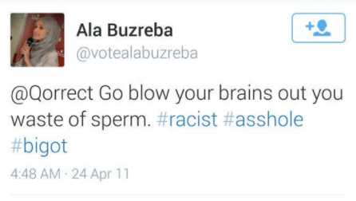
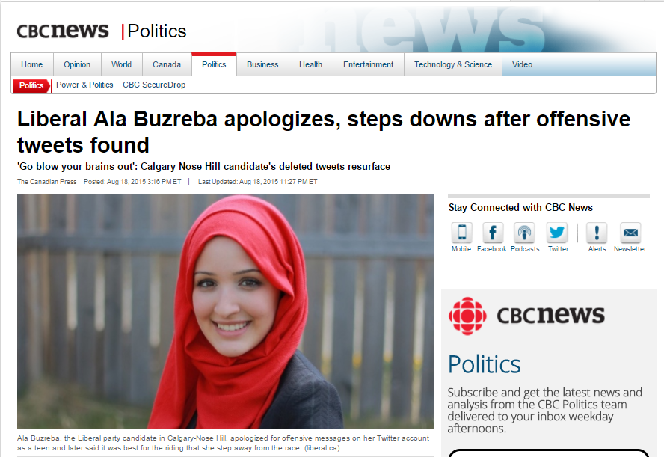
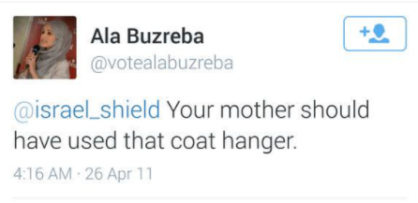
“Ephemeral reactions” can have real consequences

Slide 27
Users’ Perspective:
“Interactions are Ephemeral”
Facebook, Instagram, Twitter, Snapchat: frivolous interactions
Snapchat makes media (photos, videos) temporary and self-deleting
Notes:
social media interactions are generally considered frivolous
Snapchat explicitly embraces this ephemerality of interaction by making media temporary and self-deleting

Slide 28
Technologist Perspective
“Storage is cheap! Let’s store all the things!”
Most “internet” based interaction is archived—regardless of whether users are aware of this or not
“Chat rooms” – bots
Online games – streaming to viewers
Social media – most archive your interactions
Online forums – explicitly archived
Fundamentally: Online interactions are NOT ephemeral.

Slide 29
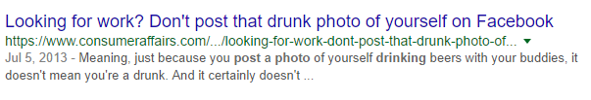
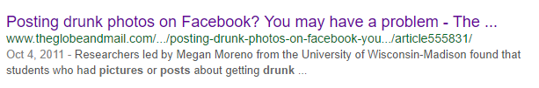
Should we be protecting participants?
Paternalistic view: YES!
“Millennial” view: We got this (?)
Notes:
Or, should we respect their implicit choices?
Savvy enough to make choices on their own, regardless of the consequences

Slide 30
Should we be protecting participants?
TCPS2: Respect for persons goes both ways – if a person has made the choice to be a part of community X, whatever the consequences are, we need to respect that choice
But is it informed consent?

Slide 31
Case study
Understanding Domestic Abuse Survivors
RQ: How do survivors discuss their experiences?
Method: Study domestic abuse survivor forums.
TCPS2: “…the privacy expectation of contributors of these sites is much higher.”
Site is indexed by Google
Membership not enforced by site
REB Q: Is this archival research?
REB Q: Are we imposing additional risk to the women posting on this forum by allowing this research (and presumably, the reproduction of their words in a publication)? (i.e. Retribution via attribution?)
REB Q: Who do we ask permission from?
Our approach: Courtesy permission from individuals (i.e. “informed consent”)
Notes:
The women that used the forum

Slide 32
Undue Paranoia?
People use the same usernames and passwords across sites
Dox’ing: practice of searching/publishing private information via searches on usernames across sites
Quotes and sentences can also be Googled fairly easily
AOL Data Release (August 2006) – “AOL Data Leak”
  Turns out, you can learn a lot from what someone searches for
Notes:
http://search-id.com/

Slide 33
Research Activities Affect Ephemerality
When researchers record what would otherwise not be recorded (e.g. recording Snapchat stream), they are making a “permanent record” of what would otherwise be ephemeral

Slide 34
Research Activities Affect Ephemerality
When researchers record what would otherwise not be recorded (e.g. recording Snapchat stream), they are making a “permanent record” of what would otherwise be ephemeral
When researchers publish quotes or media that can be used to identify users, they are reducing the ephemerality of participants’ interactions
Notice: quotes can be searched on, and the usernames can then be searched on!

Slide 35
Celebrities Read Mean Tweets
Notice how the Tweeters’ handles are visible and in plain sight!
In many of these cases, they have been flamed by the celebs’ fans into oblivion!
Notes:
https://www.youtube.com/watch?v=w1AhrEhQ0mg

Slide 36
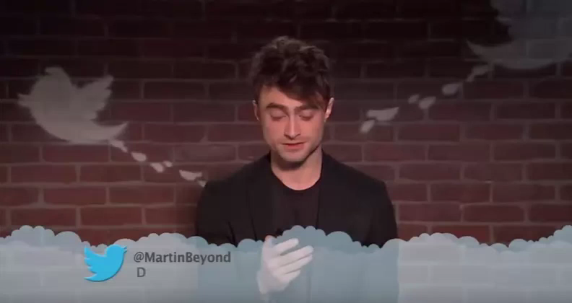

Slide 37
Celebrities Read Mean Tweets
Notice how the Tweeters’ handles are visible and in plain sight!
In many of these cases, they have been flamed by the celebs’ fans into oblivion!
What would have (essentially) remained ephemeral due to obscurity is no longer
Notes:
https://www.youtube.com/watch?v=w1AhrEhQ0mg

Slide 38
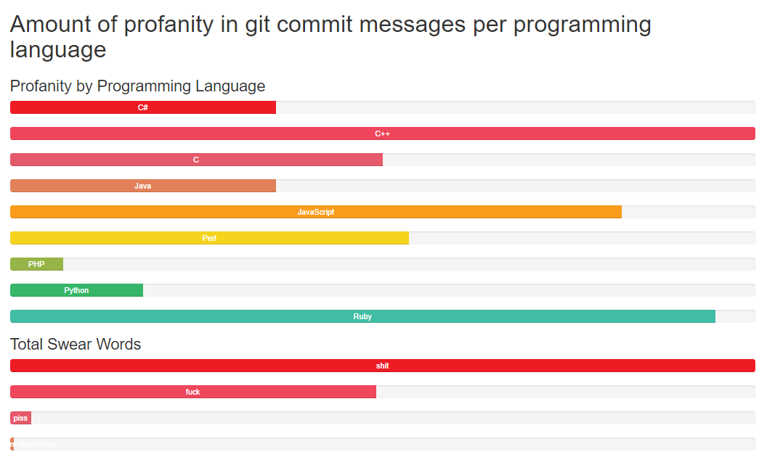
Archival research does exist
Notes:
http://andrewvos.com/2011/02/21/amount-of-profanity-in-git-commit-messages-per-programming-language

Slide 39

Archival research does exist
DIFFERENCE: With some tools (git, bug datbase, etc.), users understand that their interactions are archived and searchable
Notes:
http://andrewvos.com/2011/02/21/amount-of-profanity-in-git-commit-messages-per-programming-language

Slide 41
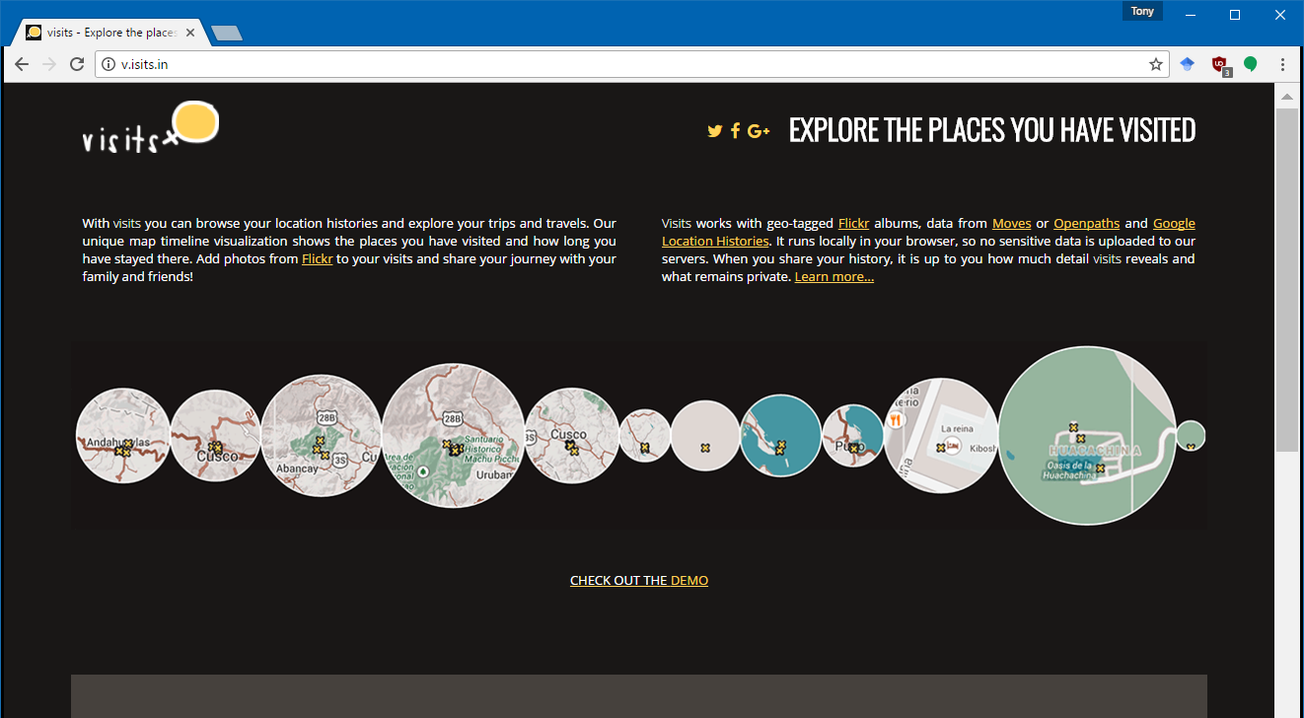
Introducing an online tool…
Alice’s traces
Notes:
18/8000

Slide 42
Practically…
Proportionate approach to REB review
It’s all about context: what is the nature of the research, what is the nature of the data, etc.
Ellard Litmus Test for Consent?

Slide 43
Outline
TCPS Framework – “first principles”
Is research in online spaces archival research?
Users’ perspectives
Technology perspective
How do we protect participants? Are we being paternalistic?
Things we know about users

Slide 44
Message
Humans have, for millennia, developed conventions for determining how ephemeral our interactions with others are.
These conventions are beginning to break because of two new technology advances:
  many Internet-based interactions are automatically archived, with unfettered public access, and
  working search engines mean that phrases and “dox’ing” information can be easily found with nominal expertise.
Protecting participants in the face of these technologies is challenging. Or… is it?
Notes:
Two new problems:
Efficient search eliminates anonymity by obscurity.
Ubiquitous indexing is not clear

Slide 45
@CanadaCreep
Clearly not informed consent. For the women, a breach of privacy—no control over likeness, no control over who sees what, and when: ephemerality of this is taken away without consent
Who do we ask for permission from? Should this depend on who/what we are studying?
What if a researcher wanted to do a study of physical spaces where they took photos of how people were dressed such that the people could not be identified? Is this better? Is it because the images are available to others? Is it really a lot better if someone didn’t take photos, but had sought to answer some research question about dress?
What is considered public?

Slide 46
Further reading
Amy Bruckman’s Ethical Guidelines for Research Online
http://www.cc.gatech.edu/~asb/ethics/
Barry Brown, Alexandra Weilenmann, Donald McMillan, and Airi Lampinen. 2016. Five Provocations for Ethical HCI Research. In Proceedings of the 2016 CHI Conference on Human Factors in Computing Systems (CHI '16). ACM, New York, NY, USA, 852-863. DOI: https://doi.org/10.1145/2858036.2858313

Slide 47
Abstract
Online spaces (social media sites, online forums, chat rooms, video games) present fundamental challenges to researchers who aim to study the people inhabiting or communicating within these spaces. For instance, what are our ethical obligations when we study people’s interactions with one another in what are effectively “publicly accessible” online spaces? What are people’s expectations of ephemerality (and privacy) in these spaces? What aspects of context matter in these cases? In this talk, I describe my experiences in studying these spaces, and discuss some of the challenges our ethics board has encountered in our efforts to protect participants when researchers propose research in the online world.

