Slide 1
Interaction Design for 2020
Dr Tony Tang
University of Calgary

Slide 2
Message
Interaction design will be harder tomorrow than it is today, because wireless connectivity, distributed devices and sensors, and AI obfuscate the function of the “system.”
As technologists, we need to recognize that our system designs are embedded with values, and ensure they are the correct values.
Ignoring these challenges will not only create unusable systems, but fundamentally dangerous ones.

Slide 3
Notes:
Personal Computing revolution

Slide 4
Notes:
1995

Slide 5
Notes:
2007

Slide 6
Notes:
1998

Slide 7
Notes:
2010

Slide 8
Notes:
Minority report 2002

Slide 9
Where’s my interaction wall?
Notes:
Personal computing revolution

Slide 10
How HCI up to 2010 got wrong
The “personal computing” revolution missed three fundamental points about life.
Life is social.
Life is embedded in everyday – it isn’t extraordinary.
Work is not all-consuming (or, we don’t want it to be).
Notice: These are values, not functions.

Slide 14
Reality of Computing Tomorrow
Internet of Things
Artificial Intelligence
Security

Slide 17
What HCI needs to get right in 2020
Life is social.
Life is embedded in everyday – it isn’t extraordinary.
Work is not all-consuming (or, we don’t want it to be).
Life is mundane.
Technologies and interfaces reflect our values, thus we need to ask and answer ourselves both philosophical and ethical questions about.

Slide 19
Cambridge Analytica
acquired considerable amount of information about a massive subset of Facebook’s user population
this information was used to unduly influence people’s opinions, and thus likely influenced voters in the 2016 US election
It does seem that the data was purchased through questionable means; however, the data was originally collected in a way that accorded with Facebook’s terms of service

Slide 20
Rise of Facebook
Founder of Facebook: “World domination!”, “Companies, not countries”
It is crazy to think that someone that wanted a better “hot or not” ended up having so much impact on the world
Notes:
https://www.vox.com/first-person/2018/4/11/17221344/mark-zuckerberg-facebook-cambridge-analytica

Slide 21
Is Facebook evil?
The role of the “newsfeed”, the role of algorithms, the impact of “bubbles”, and the power/danger of information
Was it benign? Probably? Can they be used in non-benign ways? Absolutely.
Lesson: Facebook’s design reflects a set of values (or lack of thought about values), and the #deletefacebook movement shows that it is unclear whether these reflect the values of those who use it

Slide 22
Notes:
Values?

Slide 23
Reality of Computing Tomorrow
Internet of Things
Artificial Intelligence
Security

Slide 24
Three Challenges for UX Tomorrow
Challenge 1: Understanding the system
Challenge 2: Helping the system understand us
Challenge 3: Everyday security

Slide 25
C1: Understanding the system
What is the system?
What are appropriate mental models for system state?
What are appropriate methods for interacting with and understanding the system?

Slide 26
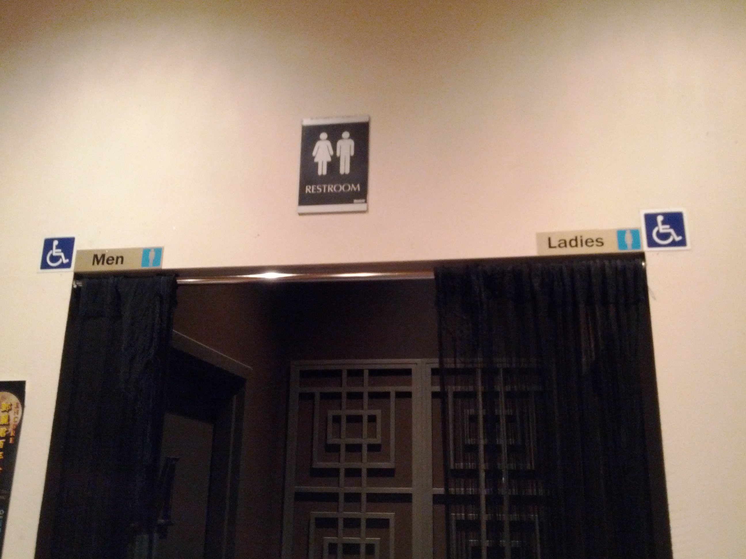

Slide 28
C1: Understanding the system
Everyday examples:
Why did the system do X?

Slide 31
C1: Understanding the system
Everyday examples:
Why did the system do X?
What is Nest’s Auto-Schedule and how does it learn?
How does YouTube recommendation system work?
Why did I see this ad?
And, when it gets it wrong, how do I fix it?

Slide 32
C2: Helping the system understand us
What aspects of context should the system know?
What kinds of common sense should the system have?
How do we tell the system what our values are?

Slide 33
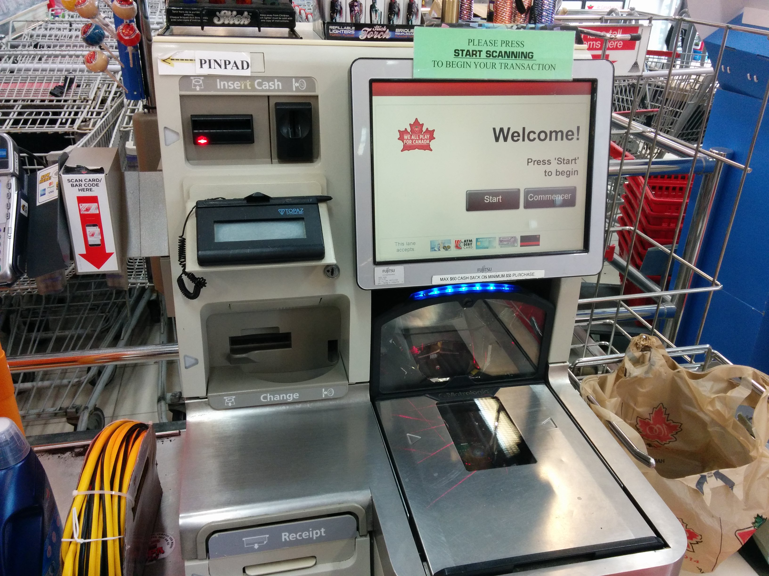

Slide 34
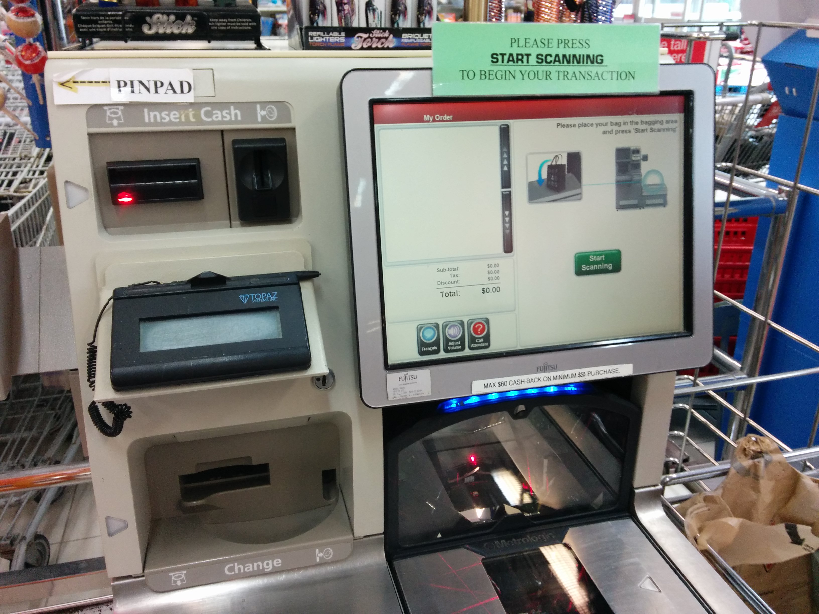

Slide 35
C2: Helping the system understand us
What aspects of context should the system know?
What kinds of common sense should the system have?
How do we tell the system what our values are?

Slide 36
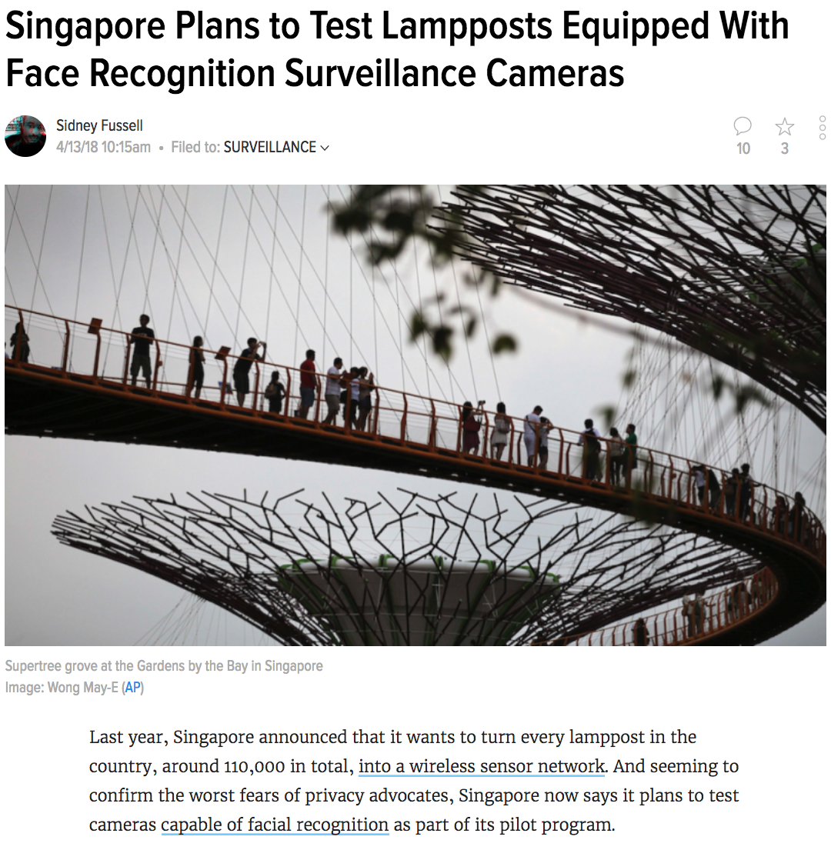

Slide 37
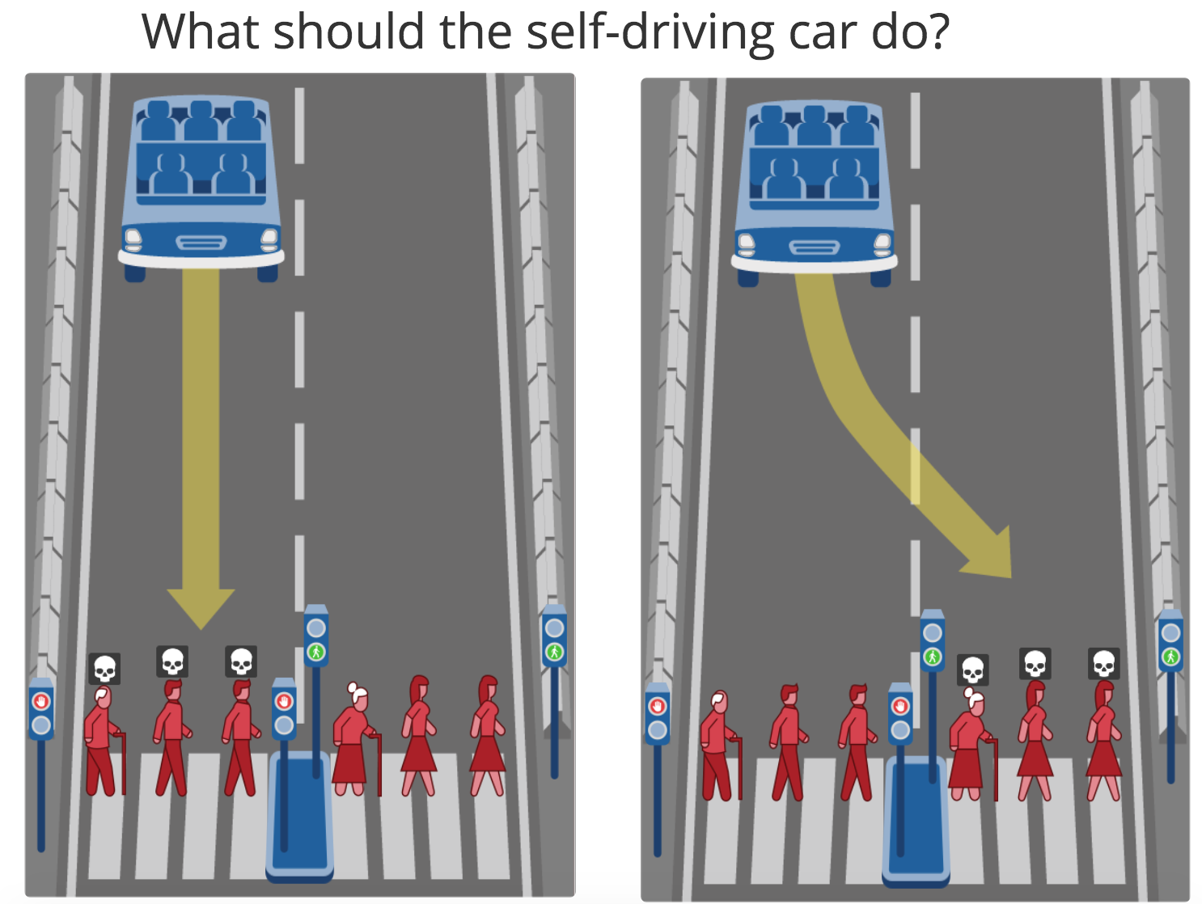
http://moralmachine.mit.edu/
Notes:
https://cdn.technologyreview.com/i/images/Ethical%20cars.png?sw=1080

Slide 38
C3: Everyday security
How do we authenticate ourselves?
How much does the system really need to know?
Should it be the same level of security to see my paycheque as it is to borrow a book at the library? Or to check my email? Or to sign up for “Kids Club” at the mall?
What are levels of risk we are willing to accept?

Slide 39
Nova Scotian “haX0r”
for i in range(1, 10000):
wget(NS_FOIP_WEB_SERVER + “/cgi-bin/?docid=“ + i);
A 19 year old had his house raided by 15 armed policemen because he downloaded FOIP documents through a publicly available web interface.
Apparently, he did it with one line of code, so my pseudocode is not as good as his actual code is.
The ease of information access does not reflect how those in charge viewed the sensitivity of the information.

Slide 41
Three Challenges for UX Tomorrow
Challenge 1: Understanding the system
Challenge 2: Helping the system understand us
Challenge 3: Everyday security
These are not strictly technical challenges; rather, they require that we introspect and understand what our collective or individual values are, and how we expect those values to be realized.
Notes:
I think there are a lot of challenges. Here are three of them.

Slide 42
Buxton Corollary about Technology
Technology is not good, and it is not evil. But, remember that it is also not neutral.

Slide 43
Message
Interaction design will be harder tomorrow than it is today, because wireless connectivity, distributed devices and sensors, and AI obfuscate the function of the “system.”
As technologists, we need to recognize that our system designs are embedded with values, and ensure they are the correct values.
Ignoring these challenges will not only create unusable systems, but fundamentally dangerous ones.

Slide 44





Message
Interaction design will be harder tomorrow than it is today, because wireless connectivity, distributed devices and sensors, and AI obfuscate the function of the “system.”
As technologists, we need to recognize that our system designs are embedded with values, and ensure they are the correct values.
Ignoring these challenges will not only create unusable systems, but fundamentally dangerous ones.
Thank you to my students and collaborators
Dr Tony Tang, PhD
tonyt@ucalgary.ca
http://ricelab.cpsc.ucalgary.ca

